Slide 1
Gaming by Noémie

Slide 2
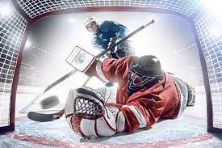
Hockey
My passion is on the ice
In my passion, it's two teams that face each other and who must put the puck in the opponent's goal and make as many points as possible by putting the puck in the opponents' goal.

