Slide 1
Passion by Robyn
The sport of soccer

Slide 2
The essence of the game
In soccer you have to score the most goals and you must defend your own goal against the other team. Also, The players skillfully move the ball around a rectangular field, which is typically made of grass, using their feet.

Slide 3
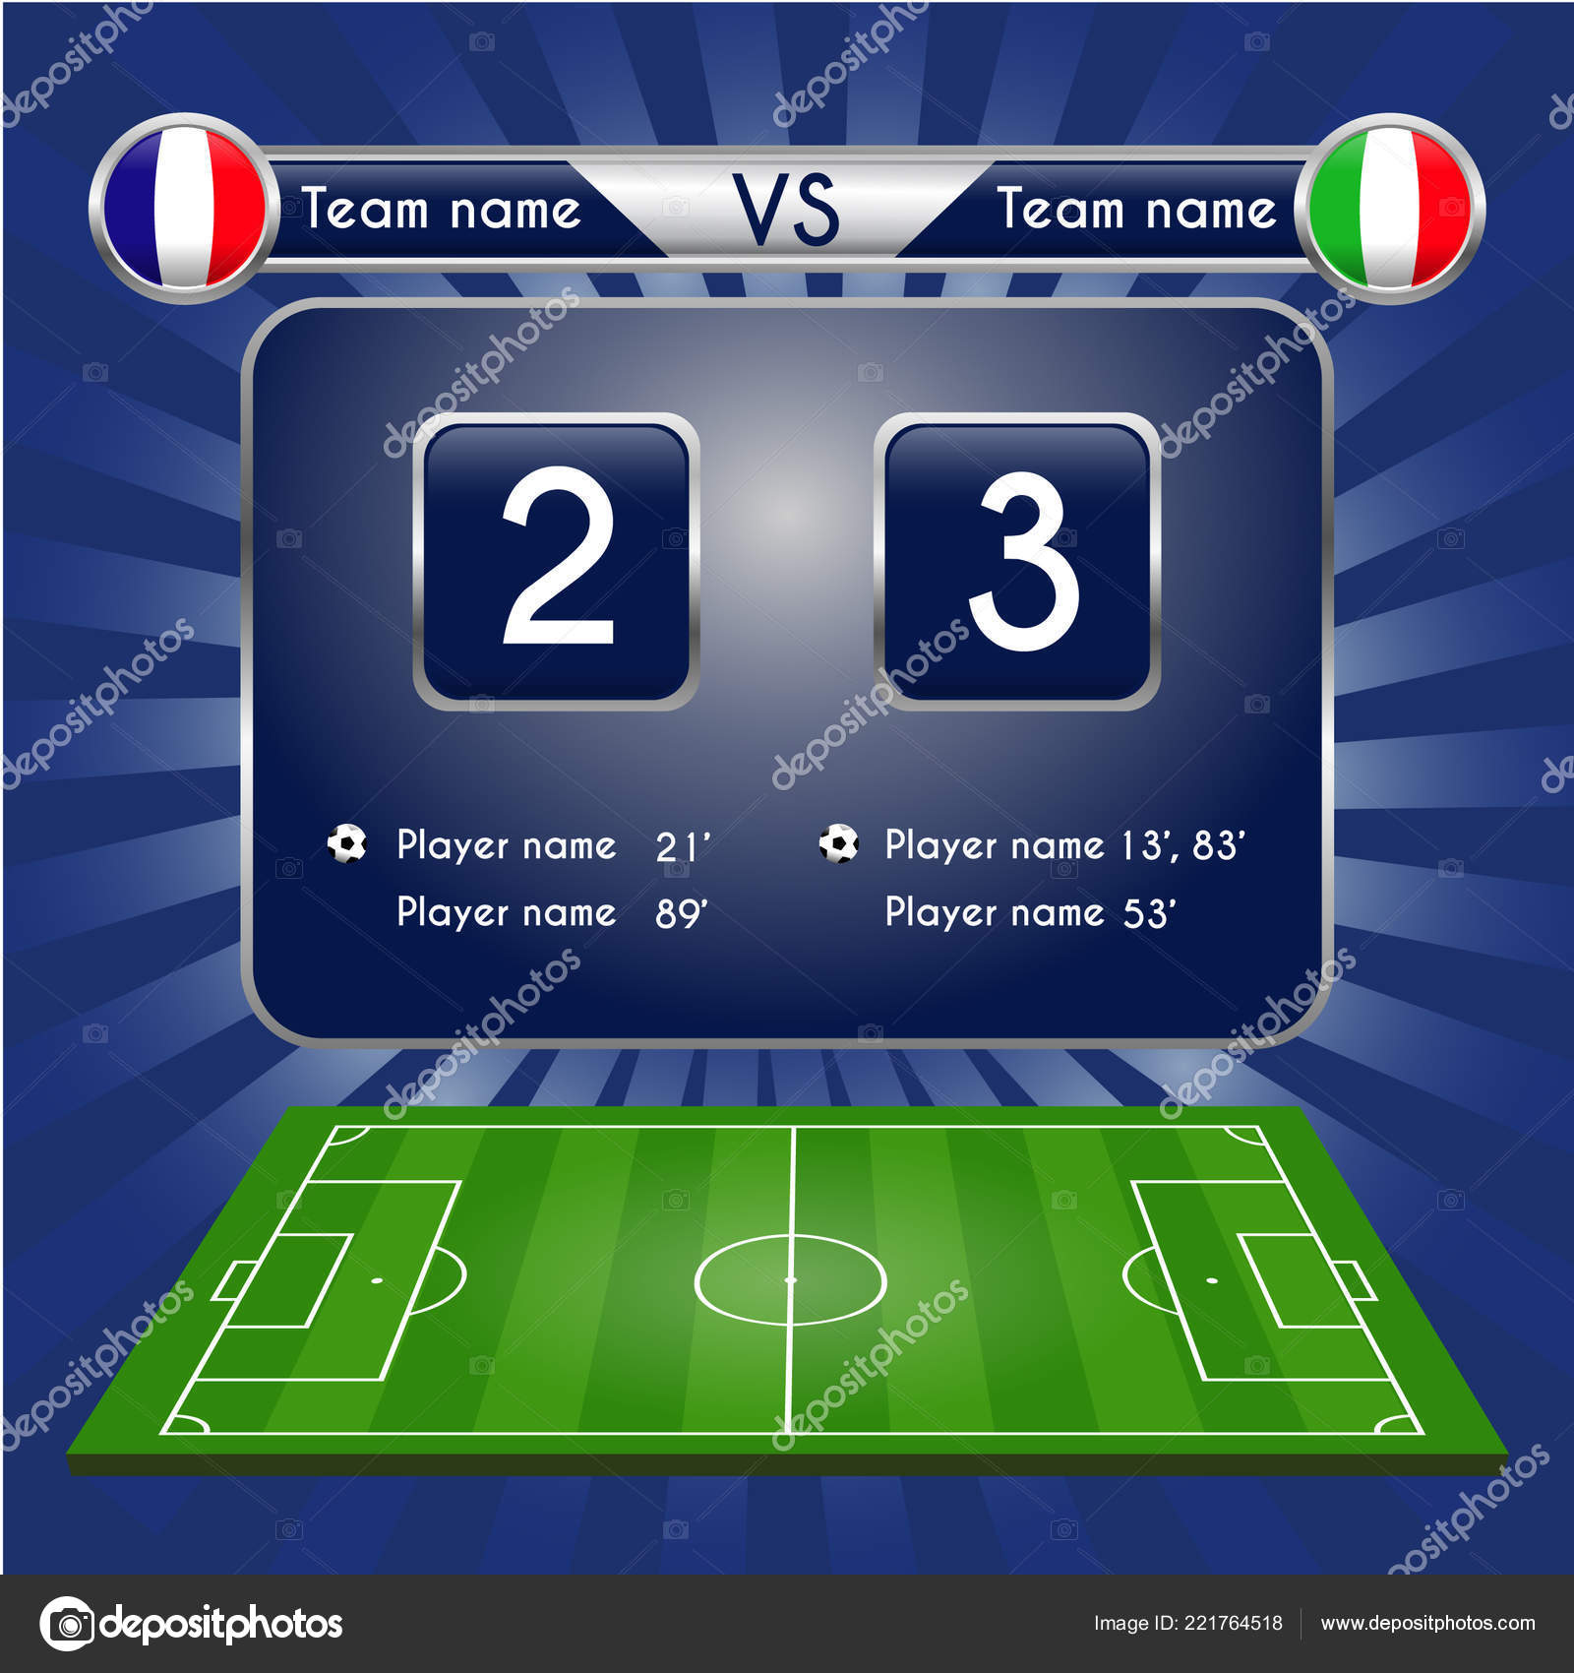
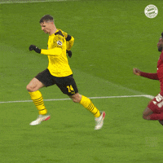
Image

